Slide 1
Camouflaging an Object from different viewpoints
Swapnil Das
Anoop

Slide 2
Problem Statement
Given multiple views of a scene and a 3D object (Cube), find surface texture that will camouflage the object to a great extent in all the views.
Why great extent ?
Not possible to find a texture that satisfies all views at the same time.
Trade-offs -
Conspicuousness of Occlusion Boundaries
Texture Distortion

Slide 3
Techniques
Biological -
Disruptive coloration – HIgh contrast markings
Masquerade – Evolution to look like uninteresting objects like twigs
Computational -
Genetic algorithms
MRF models
Greedy approach

Slide 4
Input
Given images of the scene, we use Structure-From-Motion to recreate the scene in 3D
SFM – Gives the camera parameters and SIFT keypoints in world coordinates.
This is used to place the 3D object (Cube) in the scene using Blender software.

Slide 5
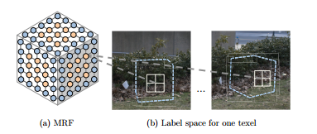
Mathematical translation of Problem Statement
Imagine a grid on the 3D object (Cube). Divide each face int 256*256 texels. Now we have to assign texture (color) to each texel.

Slide 6
Problem model as Energy Minimization
Data Costs -
Occlusion matching costs
Texture Stability
Smoothing Costs
Interior MRF -
Tries to minimize Data Costs and Smoothing cost while allowing the seams to be in the interior of the surface
Boundary MRF -
Does not allow interior seams. Tries to hide occlusion boundaries by modelling entire face as one super-node and assigning label to it.

Slide 7

Solving the MRF
Using graph-cut algorithms
Total Cost

Slide 8
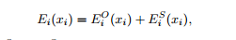
Data Cost
For the data cost, there is a trade off between matching occlusion boundaries and choosing a texture that comes from a stable view of the face:

Slide 9
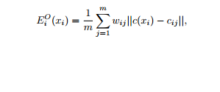
Occlusion Penalty
where c(xi) is the label’s corresponding color, cij is the
color observed at the projection of texel i into image j, and
m is the total number of views.

Slide 10
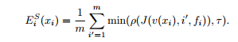
Stability Cost
Here v(xi) is the view that the texel has been assigned through its label, and fi is the texel’s face. The term J(i, i, f) is the Jacobian at the center of face f of the
change in pixel coordinates (p x, p y) at view i relative to pixel coordinates (px, py) in view i: J(i, i, f) = ∂(p x, p y)/∂(px, py). The stability function ρ sums over
both of the eigenvalues of J the penalty ρ*(λ) = α max(λ − γ, 0)2, where λ is an eigenvalue.

Slide 11
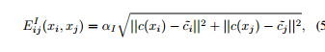
Implementation
Interior MRF
This models to hide all texture edges on the interior of the cube.

Slide 12
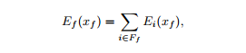
Implementation: Boundary MRF
This minimizes the same data costs as Interior MRF but only allows seams to occur at boundaries between faces (whereas the Interior MRF allows them to occur anywhere on the interior).
To remove seams on faces, we require all of the texels on a face have the same label. Thus for efficiency reasons we assign a label to the whole face, rather than to individual texels.
The data cost for one of these face “supernodes” is the cost of assigning the label to all of its texels: where xf is the label for this face, and Ff is the set of texels
belonging to this face

Slide 13
Implementation
We have used Python for the implementation. As graph cut algorithms are already there as C++(GCO) library, some code of Cython are also needed.
Also for the inputs to be processed Bundler is used.

Slide 14
Procedure
We use Markov Random Field to assign a cost of labelling each texel(pixel for cube) with a certain color.
We try to find a tradeoff between occlusion matching, interior seams, and viewpoint stability.
Then using Graph-Cut algorithm we find a solution to the MRF energy funtion.
The paper related to Graph-cut is Fast Approximate Energy Minimization via Graph Cuts

Slide 15
Output
We have used the interface of [1] for showing the images in the browser.
The views from each camera position is shown with a click to toggle for box to be there or not.

Slide 16
Experiments
We have dataset of [1] and used that with our implementation.
The dataset needed for Bundler had many requirements and random images build failed at building this step itself.

Slide 17
References
[1] Camouflaging an Object from Many Viewpoints. 2014 IEEE Conference on Computer Vision and Pattern Recognition, CSAIL, MIT
[2] Photo Tourism: Exploring Photo Collections in 3D. Noah Snavely: University of Washington, Steven M. Seitz: University of Washington, Richard Szeliski: Microsoft Research
[3] Fast Approximate Energy Minimization via Graph cuts

